Slide 1
Porter’s Competitive Forces & Value Chain Model
Business Information Systems – 420-E01
Reference: Rainer, Introduction to Information Systems, 2nd Can. Ed.
Notes:
Pfeiffer book, Chapter 3-5

Slide 2
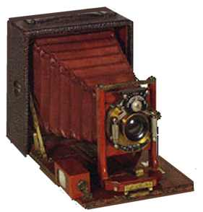
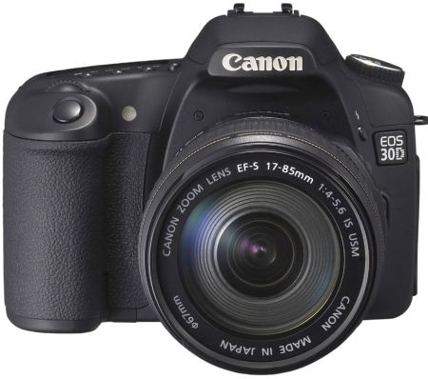
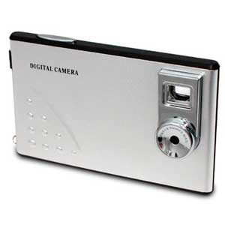
Disruptive Technology
A disruptive technology is one that displaces an established technology and shakes up the industry or a ground-breaking product that creates a completely new industry.
Example: how old analog camera were replaced by digital cameras
Innovation: “Credit
card” digital camera
Obsolescence: old analog camera

Slide 3
Supply Chains
An organization’s supply chain describes the flow of materials, information, money and services from suppliers of raw materials through factories and warehouses to end customers.

Slide 5
Competitive Advantage
A competitive strategy is a statement that identifies a business’s strategies to compete, its goals, and the plans and policies that will be required to carry out those goals.
Through its competitive strategy, an organization seeks a competitive advantage in an industry. That is, it seeks to outperform its competitors in some measure such as cost, quality, or speed.
Competitive advantage helps a company control a market and generate larger-than-average profits.

Slide 6
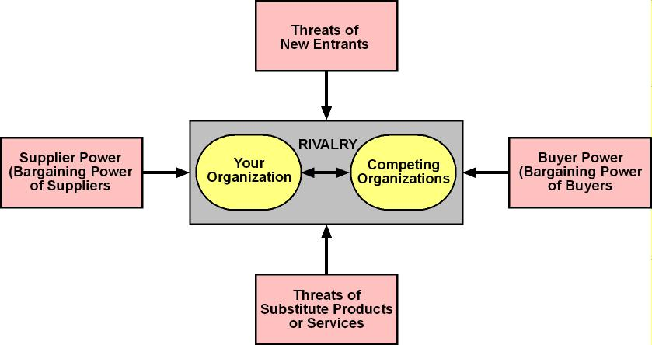
Porter’s Competitive Forces Model
Notes:
Details is also on slide 21-22.
The Threat of entry of new competitors is high when it is easy to enter a market and low when significant barriers to entry exist
A barrier to entry is a product or service feature that customers expect from organizations in a certain industry
For most organizations, the Internet increases the threat that new competitors will enter a market
The bargaining power of suppliers is high when buyers have few choices and low when buyers have many choices
Internet impact is mixed. Buyers can find alternative suppliers and compare prices more easily, reducing power of suppliers
On the other hand, as companies use the Internet to integrate their supply chains, suppliers can lock in customers
The bargaining power of buyers is high when buyers have many choices and low when buyers have few choices
Internet increases buyers’ access to information, increasing buyer power
Internet reduces switching costs, which are the costs, in money and time, to buy elsewhere. This also increases buyer power
The threat of substitute products or services is high when there are many substitutes for an organization’s products or services and low where there are few substitutes
Information-based industries are in the greatest danger from this threat (e.g., music, books, software). The Internet can convey digital information quickly and efficiently
The rivalry among firms in an industry is high when there is fierce competition and low when there is not

Slide 7
Porter’s Competitive Forces Model
Companies use Porter’s model to develop strategies to increase their competitive edge.
This model also demonstrates how IT can make a company more competitive.
5 competitive forces:
The threat of entry of new competitors
The bargaining power of suppliers
The bargaining power of customers
The threat of substitute products or services
The rivalry among existing firms in the industry

Slide 8
Porter’s Competitive Forces
The bargaining power of buyers is high when buyers have many choices and low when buyers have few choices.
Loyalty programs
The threat of substitute products or services is high when there are many substitutes for an organization’s products or services and low where there are few substitutes.
The rivalry among firms in an industry is high when there is fierce competition and low when there is not.
A barrier to entry is a product or service feature that customers expect from organizations in a certain industry.

Slide 9
Porter’s Competitive Forces
We will be using Porter’s Competitive Forces all the way through the course.
I’ve given you a handout on this topic – read it and study it.
You will need to know the 5 forces, and how to apply them on the test and final exam.

Slide 10
Porter’s Value Chain Model
Although the Porter competitive forces model is useful for identifying general strategies, organizations use Porter’s value chain model to identify specific activities that can use competitive strategies for greatest impact.
The value chain model also shows points at which an organization can use IT to achieve competitive advantage.

Slide 11
What is a Value Chain?
A value chain is a network of activities that improve the effectiveness (or value) of a good or service.
Made up of at least one, and often many business processes.
The more value a company adds to a good or service in its value chain, the higher the price the company can charge for the final product.

Slide 12
Value Chain Example
You would not be interested in a blob of rubber, but once it has been converted into a tire, the blob of rubber has gained some value.
It has even more value once you can buy it in a tire store.
It has even more value once a mechanic can install it for you.
Each of these steps in the chain are business processes, and each add some value.

Slide 13
Porter’s Value Chain Model
The activities conducted in any organization can be divided into two categories.
Primary activities –activities that relate to the production/distribution of the firm’s products & services. They add value directly to the product.
Inbound logistics (inputs), Operations (manufacturing and testing), Outbound logistics (storage and distribution), Marketing and sales, After-sales service
Support activities – do not add value directly to the firm’s products or services – they support the primary activities
Notes:
The best-known framework for analyzing competitiveness is Michael Porter’s competitive forces model (Porter, 1985).

Slide 14
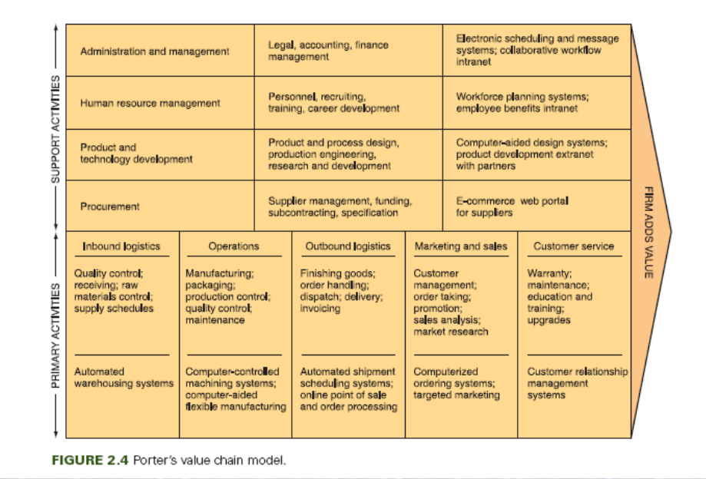
Porter’s Value Chain Model
Notes:
The best-known framework for analyzing competitiveness is Michael Porter’s competitive forces model (Porter, 1985).

Slide 15
Winterborne Bicycles
Read the case study.
Identify the value chain involved in obtaining a new bike from Winterborne Custom Bicycles.
What are the primary activities that create value for the customer when purchasing a new bike?
What information systems could be used to support these primary activities?

Slide 16
Strategies for Competitive Advantage
Organizations continually try to develop strategies to counter the 5 competitive forces.
Cost Leadership
Differentiation
Innovation
Operational Effectiveness
Customer-orientation
Notes:
Details on slide 24-25

Slide 17
Strategies for Competitive Advantage
Cost Leadership. Produce products and/or services at the lowest cost in the industry.
Ex: Walmart’s automatic inventory replenishment system – Walmart stores use floor space only to sell products and not to store them, reducing inventory costs
Differentiation. Offer different products, services or product features.
Ex: WestJet has differentiated as a low-cost, short-haul, express airline
Innovation. Introduce new products and services, add new features to existing products and services or develop new ways to produce them.
Ex: RIMs BlackBerry full QWERTY keyboard

Slide 18
Strategies for Competitive Advantage
Operational Effectiveness. Improve the manner in which internal business processes are executed so that a firm performs similar activities better than its rivals.
Increase quality, productivity, employee and customer satisfaction, while decreasing time to market
Ex. Petro-Canada replaced 150 different corporate intranet sites with one portal, which was centrally managed
Differentiation. Customer-orientation. Concentrate on making customers happy.
Ex: Web based systems are usually effective for this because they can provide a personalized, one-to-one relationship with each customer.

Slide 19
Exercise – Walmart Case Study
Read the case study.
In what ways does IT contribute to growth at Walmart?
How is Walmart using IT to share data and information with suppliers?
Why does this lead to lower prices for consumers?
What are Walmart’s recent IT innovations?
How will these lead to lower costs?

